Slide 1
Java Multi-Threading
Università di Modena e Reggio Emilia
Prof. Nicola Bicocchi (nicola.bicocchi@unimore.it)

Slide 2
Processes
In operating systems (OS), a process is an instance of a running application
A process has it own private address space, code, data, opened files, PID, etc..
Processes do not share memory (separate address spaces), thus they have to communicate through IPC mechanisms offered by the OS (i.e., pipes, signals)
A process might contain one or more threads running within the context of the process

Slide 3
Threads
Threads are sometimes called lightweight processes. Like processes, each thread has its own stack, program counter, and local variables
However, threads within the same process share the same address space and, consequently, can share variables and objects
Sharing variables is a simple and fast way threads use for communicating but frequently causes bugs unseen in single-thread programs
OOP principle of separation of concerns can be broken!

Slide 4
JVM and Operating System
A multitasking operating system assigns CPU time (slices) to processes/threads via a kernel component called scheduler. Small time-slices (5-20ms) provide the illusion of parallelism of different processes/threads (on multi-core machines it is a partial illusion)
The JVM is a process and gets the CPU as assigned by the OS’s scheduler
Java is a specification with many different implementations*
Some JVMs operate like a mini-OS and schedule their own threads
Most JVMs use the OS scheduler (a Java thread is actually mapped to a system thread)
*https://en.wikipedia.org/wiki/List_of_Java_virtual_machines

Slide 5
Threads
All Java programs have at least one thread, the main() thread
When a program starts running, the JVM creates a new thread and calls the main() method
There are other threads created by the JVM that users usually don’t interact with explicitly (e.g., garbage collector)

Slide 6
Why threads ?
There are many reasons to use threads in your Java programs. If you use Android, Swing, JavaFX, Servlets, RMI you may already be using threads without realizing it.
Main reasons for using threads:
make the UI responsive
perform asynchronous operations or background processing
take advantage of multiprocessor systems

Slide 7
Why threads ?
Imagine a stock-broker application with three key capabilities:
Download stock prices
Store stock prices into a database
Short-term analysis (1 hour) for buy/sell signals

Slide 8
Single-threaded scenario
In a single-threaded runtime environment, actions execute one after another. An action happens only when the previous one is completed.
If the download takes 10 minutes, should the user enjoy an unresponsive UI for 10 minute?
If short-term analysis takes additional 10 minute the result may come too late. Prices could already have changed significantly!

Slide 9
Multi-threaded scenario
In a multi-threated scenario
the download can execute in background (i.e. in another thread)
the analysis, too, can execute in background (i.e. in another thread) and eventually use multiple CPU cores for saving time
the user can enjoy a responsive GUI while awaiting for eventual notifications (buy/sell signals)

Slide 10
The good
Enable parallelism
Lighter than processes for both
Creation(i.e., fork())
Communication (i.e., r/w pipes …)

Slide 11
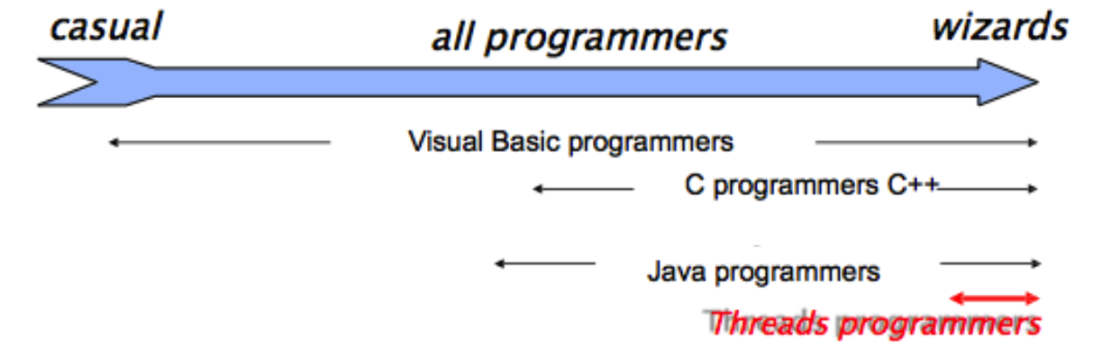
The bad
Hard for most programmers
Even for experts, development is often painful
Threads break abstraction: can't design modules independently.

Slide 12
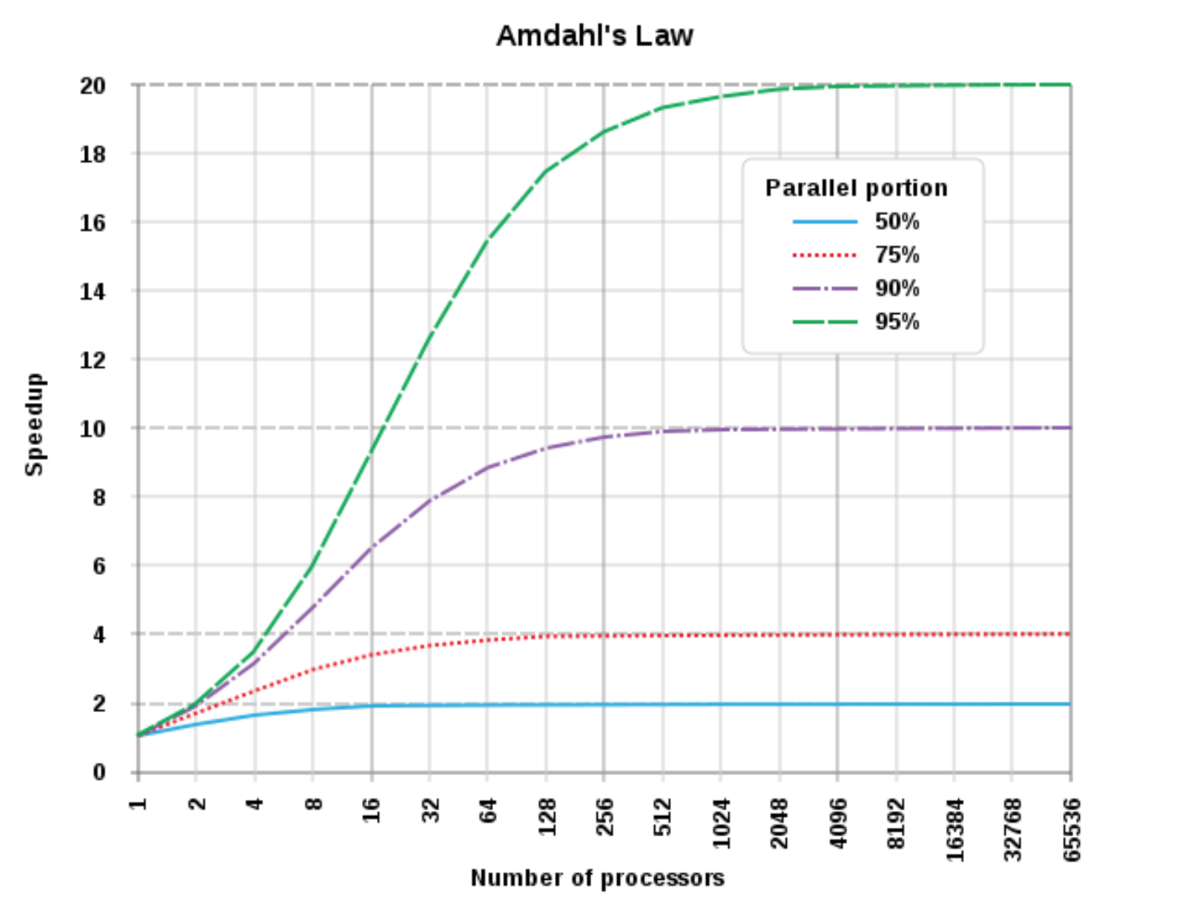
The important!

Slide 13
Creating a Process
In Java it is not possible to explicitly call the syscall fork() as in C. Syscalls fork() and exec() can be jointly called via the Process class
Methods of Process class also allow developers to acquire standard input, output, error, and exit value
/* Process p = Runtime.getRuntime().exec("/bin/ls -al /"); */
Process p = (new ProcessBuilder("/bin/ls", "-al", "/")).start();
BufferedReader in = new BufferedReader(new
InputStreamReader(p.getInputStream()));
while ((line = in.readLine()) != null) {
System.out.println(line);
}
in.close();
System.out.println(p.exitValue());

Slide 14
Creating a Thread
Threads can be created by
extending the Thread class and overriding its run() method
passing to the Thread class constructor an object implementing the java.lang.Runnable Interface
It is legal to create many threads using the same Runnable object as the target

Slide 15
Creating a Thread
Extending Thread
Class T extends Thread {
public void run() {
//code here
}
}
T t = new T();
t.start();
Implementing Runnable interface
Class R implements Runnable {
public void run() {
//code here
}
}
Thread t = new Thread(new R());
t.start();
Anonymous classes
Thread t = new Thread(new Runnable() { @Override public void run() { } });

Slide 16
Creating a Thread
class Counter implements Runnable {
public void run() {
for (int i = 0; i < 10; i++) {
System.out.println(Thread.currentThread().getName() + i);
}
}
}
public class Runner{
public static void main(String[] args) {
Thread t1 = new Thread(new Counter(), “T_A”);
Thread t2 = new Thread(new Counter(), “T_B”);
Thread t3 = new Thread(new Counter(), “T_C”);
t1.start(); t2.start(); t3.start();
}
}

Slide 17
Starting a Thread
When a Thread object is created, it does not start executing until its start() method is invoked.
When a Thread object exists but hasn't been started, it is in the new state and is not considered alive.
Method start() can be called on a Thread object only once. If start() is called more than once on same object, it will throw a RuntimeException

Slide 18
Starting a Thread
It is not guaranteed that threads will start running in the same order in which their start() methods have been called.
It is not guaranteed that a thread keeps executing until it's done (it is not guaranteed that its loop completes before another thread begins)
Nothing is guaranteed except:
Each thread will start and will run to completion after acquiring the CPU a finite number of times

Slide 19
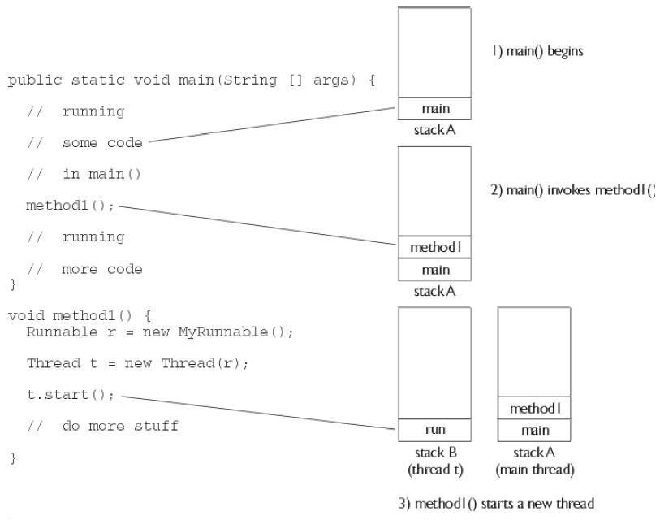
Starting a Thread

Slide 20
Thread priority
By default, a thread gets the priority of the thread creating it.
Priority values are defined between 1 and 10
Thread.MIN_PRIORITY (== 1)
Thread.NORM_PRIORITY (== 5)
Thread.MAX_PRIORITY (== 10)
Priority can be set
Thread t = new Thread(new Runnable());
t.setPriority(Thread.MAX_PRIORITY);
t.start();

Slide 21
JVM scheduling policy
A thread always runs with a priority number
The scheduler in most JVMs uses time-sliced, preemptive, priority-based scheduling
JVM specification does not require a VM to implement a time-slicing scheduler !
some JVM may use a scheduler that lets one thread stay running until it completes its run() method

Slide 22
Checking JVM scheduler
public class CheckPreemption implements Runnable {
@Override
public void run() {
while (true) {
System.out.println(Thread.currentThread().getName());
}
}
public static void main(String argv[]) {
CheckPreemption c = new CheckPreemption();
new Thread(c, "To be").start();
new Thread(c, "Not to be").start();
}
}
If the scheduler is non-preemptive the first thread chosen runs forever
If the scheduler is preemptive both threads randomly alternate

Slide 23
Terminating a Thread
If the parent thread terminates, all of its child threads terminate as well.
Child threads share resources with the parent thread, including variables. When the parent thread terminates, the child threads will not be able to access to those resources that the parent thread owns.
Thus, if the parent thread terminates earlier than its own child threads, synchronization mechanisms are required.

Slide 24
Terminating a Thread
/* start children threads */
producer.start();
consumer.start();
/* wait 1/10 of second */
Thread.sleep(100);
/* gracefully shut down children threads */
producer.running = false;
consumer.running = false;
/* wait for children before exit */
producer.join();
consumer.join();

Slide 25
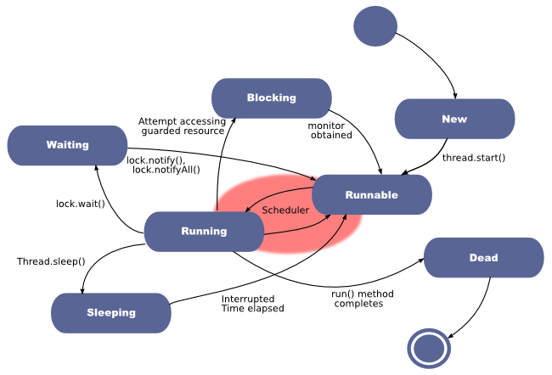
Thread states

Slide 26
Thread state: Running
The thread has been selected (from the runnable pool) to be the currently executing thread.
Transitions:
Thread.yield() (RUNNABLE)
Thread.sleep() (SLEEPING)
Thread.join() (WAITING)
Can acquire a resource but there is no work to do (WAITING)
Awaiting for a resource or I/O completion (BLOCKING)
End of run() method (DEAD)

Slide 27
Thread state: Runnable
A thread which is eligible to run, but the scheduler has not selected it to be the running thread
A thread first enters the runnable state when the start() method is invoked
A thread can also return to the runnable state after either the running, blocked, waiting, or sleeping state

Slide 28
Thread state: Waiting
A thread that can acquire a resource but there is no work to do
A thread awaiting for its children (Thread.join())
A thread which called object.wait() and waits for another thread to call object.notify()

Slide 29
Thread state: Blocking
A thread waiting for a resource
For example, awaiting for the completion of I/O operations or for an object's lock

Slide 30
Thread state: Sleeping
A thread which is sleeping after an explicit call to Thread.sleep()
Back to Runnable state when the thread wakes up because its sleep time has expired.

Slide 31
Leaving the running state (explicitly)
There are 3 ways for a thread to do it:
sleep(): the currently running thread stops executing for at least the specified sleep duration (go to sleeping state)
yield(): the currently running thread moves back to runnable to give room to other threads (go to runnable state)
join(): the currently running thread stop executing until the thread it joins completes (go to waiting state)
end of run() method: go to dead state

Slide 32
sleep()
try {
// Sleep for 1 second
Thread.sleep(1000);
} catch (InterruptedException ex) {
//
}

Slide 33
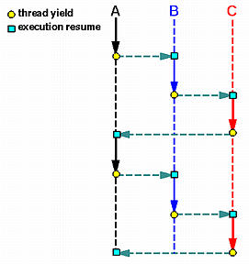
yield()
The method yield() make the currently running thread back to Runnable state
It allows other threads to get their turn (with no guarantees)
The yielding thread can be scheduled again for execution
Code is less dependent from the scheduler type, because threads release CPU when needed.
Frequently used when computation is not possible (no work to do) in a specific time slice.

Slide 34
join()
A thread can execute a thread join to wait until the other thread terminates. In general, thread join is for a parent to join with one of its child threads. Thread join has the following activities, assuming that a parent thread P wants to join with one of its child threads C
When P executes Thread.join() in order to join with C, which is still running, P is suspended until C terminates. Once C terminates, P resumes
When P executes Thread.join() and C has already terminated, P continues as if no such thread join has ever executed

Slide 35
join()
The join() method lets one thread "join onto the end" of another thread.
Thread t = new Thread();
t.start();
t.join();
Caller move to Waiting state and it will be Runnable when thread t is dead. A timeout can be set to wait for a thread’s end
t.join(5000);
// wait t for 5 seconds: if t is not finished
// then current thread is Runnable again

Slide 36
A word of advice
Some methods may look like they tell another thread to block, but they don't.
If t is a thread object reference, you can write something like: t.sleep() or t.yield()
However, they are static methods of Thread:
they don't affect the instance t !!!
instead they affect the thread which is currently in execution
Using an instance variable to access a static method is error-prone!

Slide 37
Thread Synchronization

Slide 38
Synchronization
What happens when two different threads are accessing the same data ?
Imagine two people (represented by two threads) each one having an ATM card linked to the same account
class Account {
private int balance;
public int getBalance() {
return balance;
}
public void withdraw(int amount) {
balance -= amount;
}
}

Slide 39
Synchronization
Each person (i.e., thread) does these steps
Decide an amount to withdrawal
Check the balance of the account
If there's enough money, withdrawal the decided amount
What happens if the scheduler suspends one thread between step 2 and step 3 and the other one gets executed?

Slide 40
Synchronization
Homer decides to withdraw 100$ and verifies that the account contains 125$!
Marge enters the status RUNNING
Marge decide to withdraw 120$ and verifies that the account contains 125$ !
Marge withdraws 120$
Homer enters the status RUNNING
Homer withdraw 100$ (he has already checked!) but the ATM gives him only 5$

Slide 41

Race condition
A problem arising whenever two or more threads share the same resource and one thread "races in" too quickly before another operation (supposed to be atomic) has been completed

Slide 42
Preventing Race Conditions
We must guarantee that the steps comprising the withdrawal process are NEVER split apart
Withdrawal must be an atomic operation
Any withdrawal (accomplished by one thread) must be completed before any other thread is allowed to act on the account
Regardless of the number of actual instructions!

Slide 43
Synchronized
Developers can't guarantee that a single thread will stay running during a whole operation (supposed to be atomic for avoiding race conditions). In fact, developers can not control the scheduler (excluding the case of calling yield()).
In Java, synchronized methods are used to protect access to resources that are accessed concurrently. Only one thread at a time can access
The modifier synchronized can be applied either to a method or an object

Slide 44
Synchronization and Locks
public synchronized void doStuff() {
System.out.println("synchronized");
}
/* is equivalent to… */
public void doStuff() {
synchronized(this) {
System.out.println("synchronized");
}
}

Slide 45
Synchronization and Locks
Every object in Java has ONE built-in lock
Entering a synchronized non-static method means getting the lock of the object. If one thread gets the lock, all other threads have to wait to enter ALL the synchronized code until the lock is released (the first thread exits the synchronized method)
Entering a synchronized static method means getting the lock of the class instead of an object. Useful when the shared resource is defined static as well.

Slide 46
Synchronization and Locks
Whenever an object lock has been acquired by one thread, other threads can still access the class's non-synchronized methods. Methods that don't access critical data don’t need to be synchronized
Details:
Threads going to sleep don't release locks!
A thread can acquire more than one lock. For example, a thread can enter a synchronized method, then immediately invoke a synchronized method on another object (deadlock prone!)

Slide 47
Synchronized code
Despite threads can be used for solving a number of real-world problems, most of them can be conceptually assimilated to two main patterns:
The producer-consumer pattern, where the producer thread pushes elements into a shared object and the consumer thread fetches (consumes) them
The manager-worker pattern, where a manager decomposes a complex task into subtask, and assigns them to worker threads.

Slide 48
Producer Consumer
Shared queue
Producer #1
Consumer #1
Producer #2
Consumer #2
Producer #3
Consumer #3

Slide 49
Manager Workers
Work
Manager
Worker #1
Worker #2
Worker #3
Worker #4

Slide 50
Synchronized code
There are two main ways to grant atomic access to a shared object:
Use synchronize explicitly to lock the shared object within the threads code (@see Account example)
Use a thread-safe class as shared objects (they use synchronized on their methods) (@see GranularityExample)

Slide 51
Thread-safe classes
A thread-safe class is class that is safe (works properly) when accessed by multiple threads. Critical sections (i.e., sections possibly generating race conditions) are encapsulated in synchronized methods.
Interface List: ArrayList (unsafe), Vector (safe)
Interface Queue: LinkedList (unsafe), ConcurrentLinkedQueue (safe), ArrayBlockingQueue (safe)

Slide 52
Collections.synchronized*
Return a synchronized (thread-safe) Collection/Map backed by the specified Collection/Map. In order to guarantee serial access, it is critical that all access to the backing Collection/Map is accomplished through the returned Collection/Map.
It is imperative that the user manually synchronize on the returned Collection/Map when iterating over it! Failure to follow this advice may result in non-deterministic behavior.
List list = Collections.synchronizedList(new ArrayList());
...
synchronized (list) {
Iterator i = list.iterator(); // Must be in synchronized block
while (i.hasNext())
foo(i.next());
}

Slide 53
Synchronization using Object
Threads might be able to acquire exclusive access a shared resource but still be unable to progress. For example, a producer with a full queue, or a consumer with an empty queue
To avoid waste of computational resources we can use wait() and notify()

Slide 54
wait()
wait() is an instance method that’s used for thread synchronization. It can be called on any object, as it’s defined in java.lang.Object
wait() can only be called from a synchronized block. It releases the lock on the object so that another thread can jump in and acquire a lock.
Simply put, wait() method lets a thread say:
“There's nothing for me to do now, so put me in the waiting pool and notify me when something happens that I care about.”

Slide 55
notify()
The notify() method send a signal to one of the threads that are waiting in the same object's waiting pool.
The notify() method CANNOT specify which waiting thread to notify.
The method notifyAll() is similar but sends a signal to all the threads waiting on the object.
Simply put, notify() method lets a thread say:
“Something has changed here. Feel free to continue what you were trying to do”

Slide 56
Thread issues
If code is correctly synchronized, it still might not work. The main issues are:
Deadlock (indefinite wait)
Livelock (threads running but no work gets done)
Starvation (thread never executes)

Slide 57
Deadlock
Deadlock occurs when two threads are blocked, with each other waiting for the other’s lock.
Neither can run until the other gives up its lock, so they wait forever
Poor design can lead to deadlock
It is hard to debug code to avoid deadlock
Model checking could be a solution (problem: state space explosion)

Slide 58

Deadlock

Slide 59
Livelock
A thread often acts in response to the action of another thread. If the other thread's action is also a response to the action of another thread, then livelock may result.
As with deadlock, livelocked threads are unable to make further progress.
However, the threads are not blocked — they are simply too busy responding to each other to resume work.

Slide 60
Starvation
Starvation describes a situation where a thread is unable to gain regular access to shared resources and is unable to make progress.
For example, suppose an object provides a synchronized method that often takes a long time to return. If one thread invokes this method frequently, other threads that also need frequent synchronized access to the same object will often be blocked.

Slide 61

Starvation

Slide 62
Recap: Threads are tricky
Synchronization
Must coordinate access to shared data with locks. Forgot a lock? Enjoy little predictable runtime errors
Performance issues
Simple locking yields low concurrency
Fine-grained locking increases complexity
Hard to debug

Slide 63
